Slide 1
NYC 311 Service Requests Analysis Exploratory Data Analysis Using Open Government Data
|
Presented by: Tanti Meet, Jay Shah, Madhav Mashru, Ritwik Patil

Slide 2
Agenda
| Introduction
What is NYC 311 and why this dataset matter
| Dataset Overview
Source, structure, key columns
| Exploratory Data Analysis
Complaint types, boroughs, time patterns, agency response
| Insights & Patterns
What the data reveals about NYC issues
| Recommendations
What can be improved
| Conclusion
Final thoughts + future possibilities

Slide 3

What Are NYC Residents Complaining About ?
Over 18 million 311 complaints have been recorded since 2010 – from noise and sanitation to public safety and streetlights. What can this data tell us?

Slide 4

Let’s Understand the Dataset Before the insights, let’s look at the data we’re working with
Unique Key | Created Date | Agency | Complaint Type | Resolution Action Updated Date | Borough
64414281 | 03/20/2025 03:19:28 PM | NYPD | Noise - Residential | 03/20/2025 05:02:07 PM | BROOKLYN
64414794 | 03/20/2025 03:19:22 PM | NYPD | Illegal Parking | 03/20/2025 03:39:46 PM | BROOKLYN
64414181 | 03/20/2025 03:19:00 PM | DOT | Street Light Condition |  | BROOKLYN
64411248 | 03/20/2025 03:18:53 PM | NYPD | Abandoned Vehicle | 03/20/2025 09:28:23 PM | QUEENS
64417264 | 03/20/2025 03:18:41 PM | NYPD | Blocked Driveway | 03/20/2025 03:46:25 PM | BRONX
Contain 45+ columns
Covers 5 boroughs and thousand of location
(Manhattan, Brooklyn, Queens, Staten Island and The Bronx)

Slide 5
Key Statistics from the Dataset | “Before diving deep, let’s summarize what the dataset holds”
📊 Total Records Analyzed: ~46,000+ service request entries
📁 Columns in Dataset: 41 features including timestamps, location, and agency
📌 Complaint Types: Over 100+ unique issues reported
🗺️ Boroughs Covered: All 5 boroughs – Manhattan, Brooklyn, Bronx, Queens, Staten Island
🏢 Top Agencies Handling Complaints:
NYPD (Noise, Parking)
DOT (Street Conditions, Lights)
DSNY (Sanitation)
| Now that we understand what our data looks like, let’s dive into what it tells us…

Slide 6
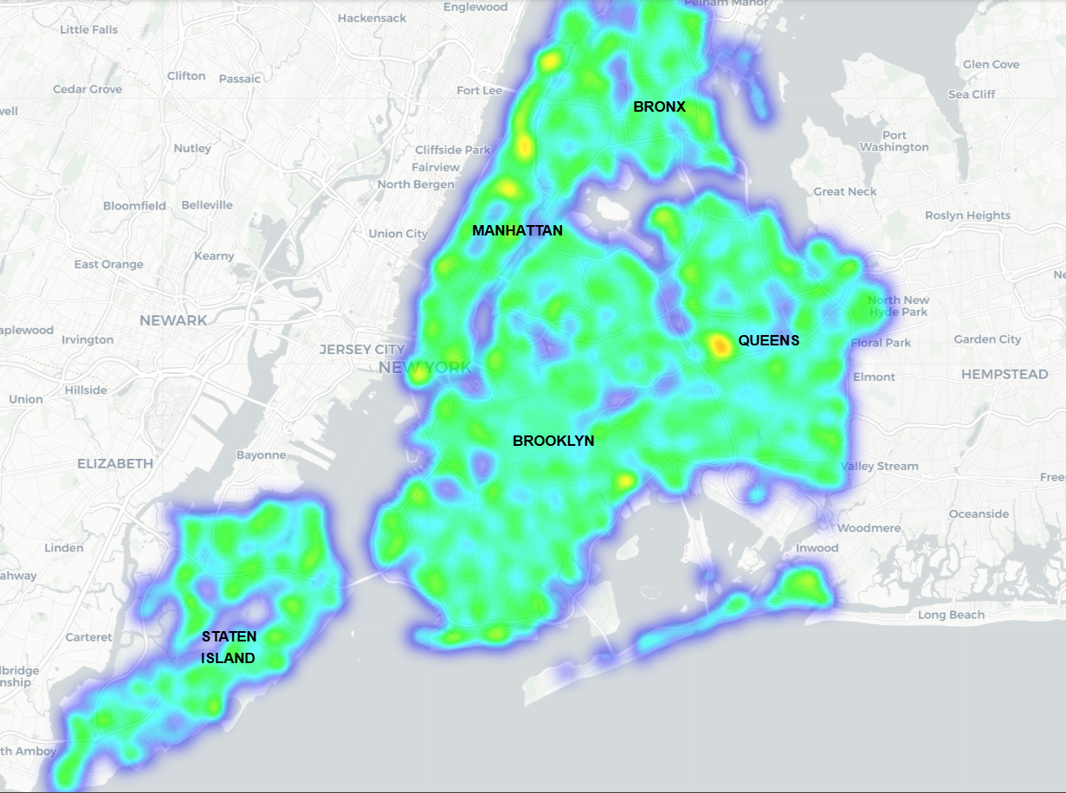
Heatmap of Complaints based on Borough

Slide 7
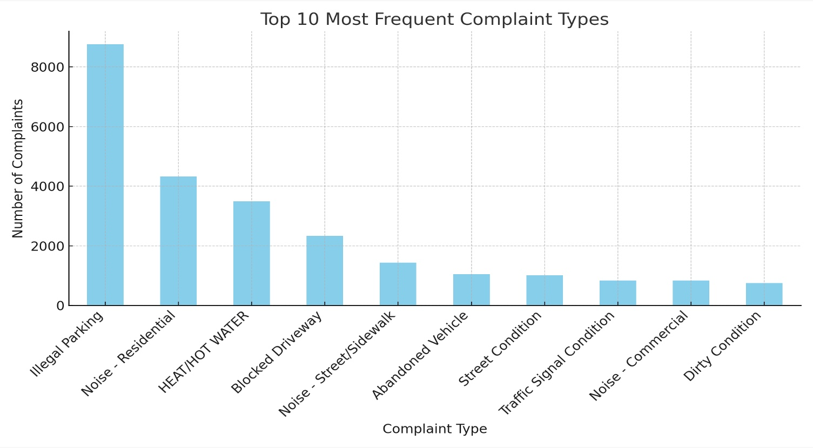
Top Complaint Types in NYC
The most frequent 311 complaint types
Illegal parking & Noise – Residential is the most common complaint types.
Other top complaints include Heat/Hot Water, Blocked Driveway.
These reveal public frustration around neighborhood disturbances and infrastructure.
| Now that we know what people complain about the most, let’s see where these complaints come from.

Slide 8
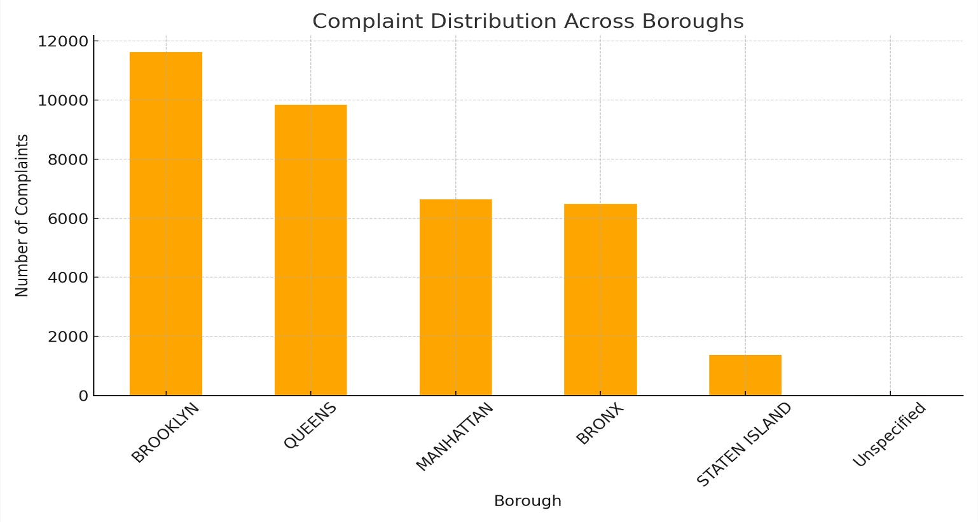
Top Complaints by borough
Brooklyn reports the most complaints, followed closely by Manhattan
Staten Island has the fewest complaints – likely due to smaller population
The trend reflects borough population density and urban activity
| Does more population mean more complaints... or better awareness ?

Slide 9
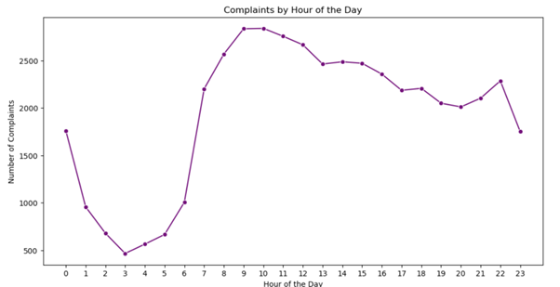
Complaint Trends by Time of Day
| Peak complaint hours are between 6 PM and 10 PM
This is when residents are most active at home, leading to
increased reports – especially for noise and parking issues.
| Early morning and late – night complaints are minimal
Very few reports happen between 1am and 6am, likely due
to people being asleep or less active.
| Evening hours are critical for city response planning
These trends suggest that agencies like NYPD and DOT
should have increased presence or staff during these hours.

Slide 10
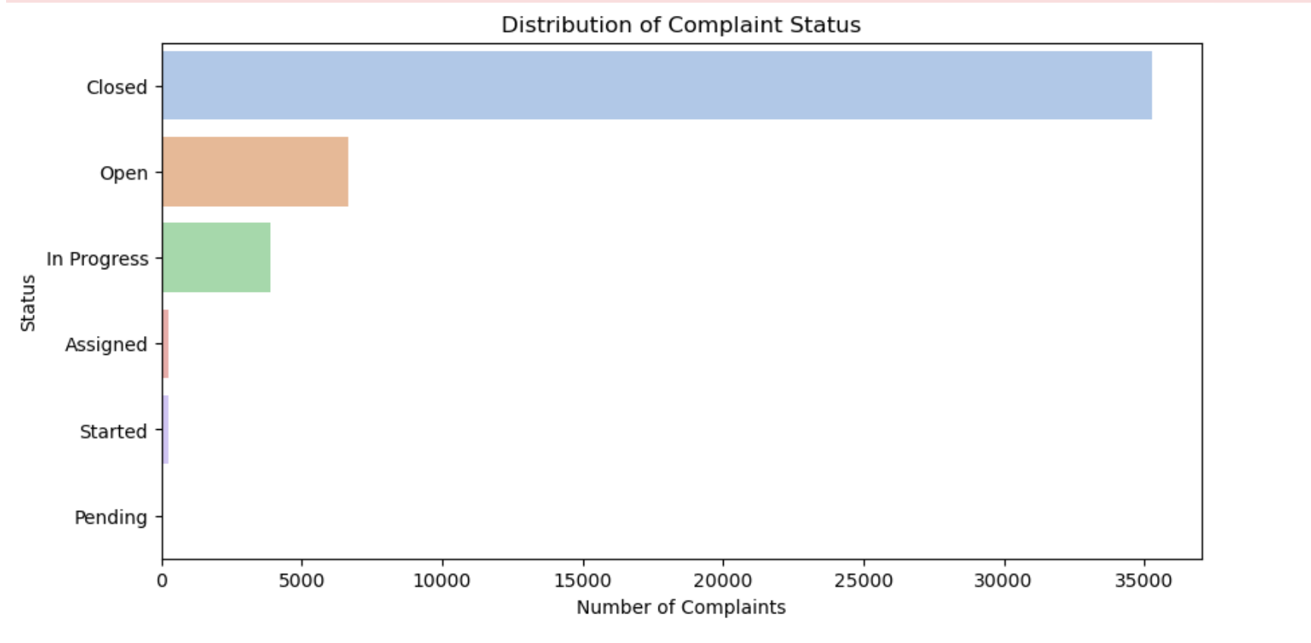
Status of 311 Complaints in NYC
✅ Over 35,000 complaints are marked as Closed, showing strong follow-up across departments.
📌 Open and In Progress statuses still account for thousands of active cases.
⏳ Pending, Started, and Assigned are minimal but reflect issues in early response stages.
📈 High closure rate suggests city responsiveness, but open/in-progress volumes may indicate growing workload or slower follow-up in certain categories.
| While the city resolves most cases, thousands remain open or in progress — highlighting opportunities for improved turnaround.

Slide 11
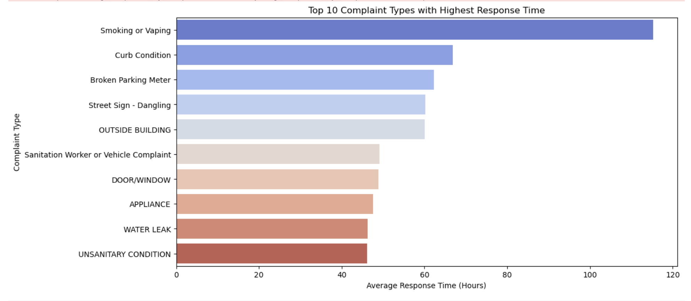
Complaints with the Longest Response Time
🚨 “Smoking or Vaping” has the highest average response time — nearly 115 hours, likely due to low urgency or enforcement challenges.
🛣️ Curb Condition and Broken Parking Meter also take over 70 hours on average to resolve.
⚠️ Infrastructure-related issues such as Street Signs, Appliances, and Water Leaks are slower to address, possibly due to resource constraints or inspection needs.
🧹 Even Sanitation Worker Complaints and Unsanitary Conditions can take more than 45–50 hours, impacting resident satisfaction.
| Higher response times on these complaint types may signal the need for specialized task forces or clearer escalation workflows.

Slide 12
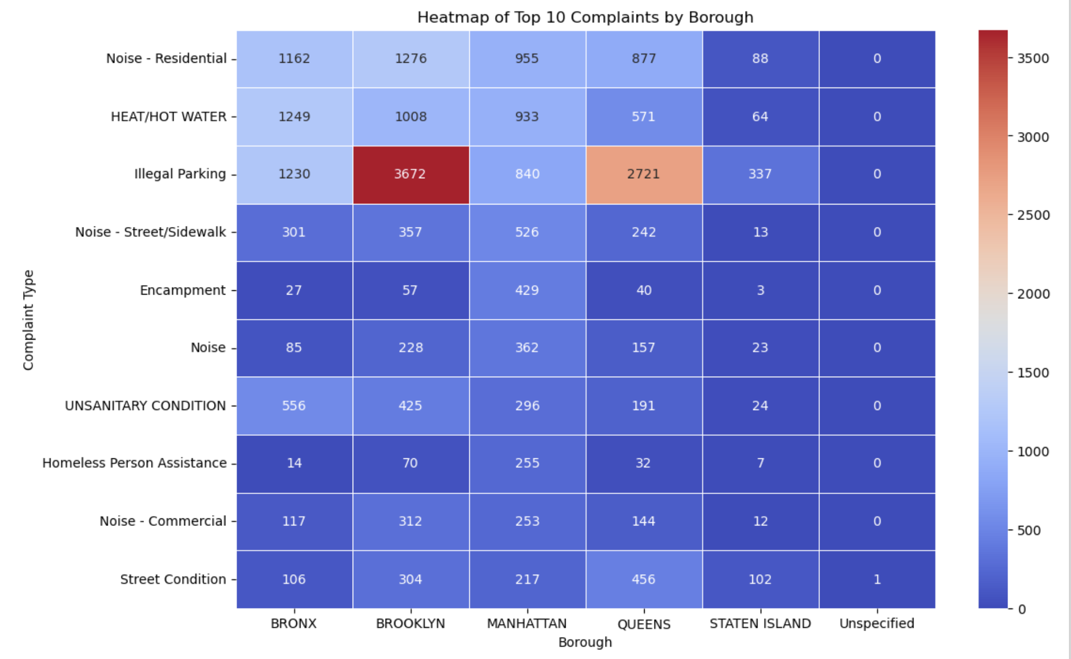
Top Complaints by Borough (Heatmap)
Illegal Parking is the leading complaint in Brooklyn and Queens, highlighting major residential parking issues.
Noise - Residential is consistently high across all boroughs, showing it’s a widespread urban concern.
Heat/Hot Water and Unsanitary Conditions are especially reported in the Bronx, indicating possible housing and sanitation challenges.

Slide 13
Agency Response Time Analysis
Agency | Avg. Resolution Time (hrs) | Fastest Response (hrs) | Slowest Response (hrs)
NYPD | 14.2 | 1.5 | 96
DOT (Transportation) | 37.8 | 5 | 160+
DSNY (Sanitation) | 28.5 | 3 | 120
DEP (Environmental) | 42 | 6.2 | 180+
NYPD resolves complaints faster on average than other agencies. DOT & DEP show a wider spread with longer resolution delays.
Some complaints remain unresolved beyond 10 days – these are often infrastructure – related.
| Now let’s summarize our main insights and key takeaways from this analysis

Slide 14
Key Insights & Takeaways
| Noise – Residential
Is the most reported complaint citywide
| Brooklyn
Leads in complaint volume, followed by Manhattan.
| Peak reporting hours are between 6pm – 10pm
Mainly for noise and parking.
| NYPD has the fastest resolution times
while DOT lags on infrastructure – related issues
Some complaints remain unresolved for 10+ days, especially in sanitation or street conditions.
| These insights can help city planner improve services, response time, and resource allocation.

Slide 15
Recommendations for city Improvement
Focus Area | Recommendation
🕕 Evening Patrols | Increase NYPD and noise regulation teams between 6 PM – 10 PM, when most complaints are reported.
🚧 Faster DOT Response | Improve resolution time for street conditions and traffic light issues handled by the Department of Transportation.
🧹 Sanitation Services | Allocate more DSNY resources to high-complaint boroughs like Brooklyn and Bronx.
⏳ Track Long-Open Cases | Create alerts for complaints that remain unresolved for more than 10 days.
🗺️ Data-Driven Planning | Use heatmaps and ZIP-code data to deploy teams where complaint density is highest.

Slide 16
Thank you
|
Course: Python Programming – Midterm Project (EDA)
Dataset: NYC 311 Service Request (via NYC Open Data)
Submission Date: April 2, 2025

